Slide 1
Lecture-7
Resilience, Tolerance and Time-management
Life Skills and Effective Communication
Dept. of Humanities and Social Sciences, JIIT Noida

Slide 2
Topics to be covered
Interpersonal Skills
What is resilience
7 Cs of resilience
Skills to build resilience
Types of resilience
Tolerance
Types of tolerance
Self belief
Time management
Benefits of time-management
Steps in time-management
POSEC method of time-management

Slide 3
What is Resilience?
1. Ability to bounce back.
2. Adapting to hardships and setbacks in life.
3. Resilience is a skill anyone can learn and develop.
4. No matter your age and stage of life, you can always improve your resilience.
Psychologists define resilience as the process of adapting well in the face of adversity, trauma, tragedy, threats, or significant sources of stress—such as family and relationship problems, serious health problems, or workplace and financial stressors. As much as resilience involves “bouncing back” from these difficult experiences, it can also involve profound personal growth.

Slide 4
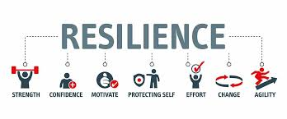
RESILIENCE IS..
…developed over time.
…something that you cultivate
…attitudes and skills that
can be learned and practice
a universal human ability to thrive in spite of setbacks
RESILIENCE IS NOT..
…something you’re born with
…something you can buy.
…immunity or absence of pain, loss, or negative emotion.
…a “quick fix.”
…unique to any specific groups of people.

Slide 5
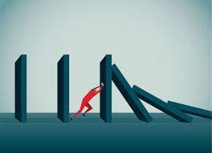
How to be resilient…
Imagine you’re going to take a raft trip down a river. Along with slow water and shallows, your map shows that you will encounter unavoidable rapids and turns. How would you make sure you can safely cross the rough waters and handle any unexpected problems that come from the challenge?
Perhaps you would enlist the support of more experienced rafters as you plan your route or rely on the companionship of trusted friends along the way. Maybe you would pack an extra life jacket or consider using a stronger raft. With the right tools and supports in place, one thing is sure: You will not only make it through the challenges of your river adventure. You will also emerge a more confident and courageous rafter.

Slide 6
7 C’s of Resilience
The American Academy of Pediatrics summarizes the 7 Cs as follows:
Competence This is the ability to know how to handle situations effectively. To build competence, individuals develop a set of skills to help them trust their judgments and make responsible choices.
Confidence True self-confidence is rooted in competence. Individuals gain confidence by demonstrating competence in real-life situations.
Connection Close ties to family, friends, and community provide a sense of security and belonging.
Character Individuals need a fundamental sense of right and wrong to make responsible choices, contribute to society, and experience self-worth.
Contribution Ginsburg says that having a sense of purpose is a powerful motivator. Contributing to one’s community reinforces positive reciprocal relationships.
Coping When people learn to cope with stress effectively, they are better prepared to handle adversity and setbacks.
Control Developing an understanding of internal control helps individuals act as problem-solvers instead of victims of circumstance. When individuals learn that they can control the outcomes of their decisions, they are more likely to view themselves as capable and confident.

Slide 7
Skills to build Resilience
Maintain a realistic and logical outlook
Use direct communication and adapt your style to fit the situation
Problem-solve when faced with challenges
Seek internal validation (from yourself)
Attend to physical and emotional health
Know when and how to say “No”
Celebrate your accomplishments, big and small
Accept compliments and credit for your work
Believe in yourself and your abilities
Practice healthy inter-dependence with others
Know when to ask for help

Slide 8
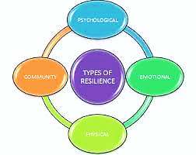
Types of Resilience
The word resilience is often used on its own to represent overall adaptability and coping, but it can be broken down into categories or types:
Psychological resilience
Emotional resilience
Physical resilience
Community resilience

Slide 9
What is Psychological Resilience?
Psychological resilience refers to the ability to mentally withstand or adapt to uncertainty, challenges, and adversity. It is sometimes referred to as “mental fortitude.”
People who exhibit psychological resilience develop coping strategies and capabilities that enable them to remain calm and focused during a crisis and move on without long-term negative consequences.
What is Emotional Resilience?
There are varying degrees of how well a person copes emotionally with stress and adversity. Some people are, by nature, more or less sensitive to change. How a person responds to a situation can trigger a flood of emotions.
Emotionally resilient people understand what they’re feeling and why. They tap into realistic optimism, even when dealing with a crisis, and are proactive in using both internal and external resources. As a result, they are able to manage stress as well as their emotions in a healthy, positive way.

Slide 10
What is Physical Resilience?
Physical resilience refers to the body’s ability to adapt to challenges, maintain stamina and strength, and recover quickly and efficiently. It’s a person’s ability to function and recover when faced with illness, accidents, or other physical demands.
Healthy lifestyle choices, building connections, making time to rest and recover, deep breathing, and engaging in enjoyable activities all play a role in building physical resilience.
What is Community Resilience?
Community resilience refers to the ability of groups of people to respond to and recover from adverse situations, such as natural disasters, acts of violence, economic hardship, and other challenges to their community.
Real-life examples of community resilience include New York City following the 9/11 terrorist attacks; New Orleans following Hurricane Katrina. The COVID-19 pandemic, our resilience in the face of this unprecedented public-health emergency is being tested as never before.

Slide 11
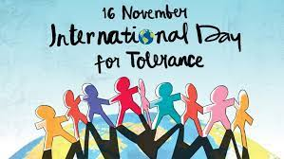
Tolerance
The noun tolerance, which stems from the Latin for "endurance," also refers to an organism's ability to stand or handle a difficult environmental condition. If you build up a tolerance, you can handle large amounts of something (from medicine to psychological abuse) without being too strongly affected. Tolerance is the appreciation of diversity and the ability to live and let others live.
We usually use the word to refer to our need to accept others, as suggested by John F. Kennedy when he said,
“Tolerance implies no lack of commitment to one's own beliefs. Rather it condemns the oppression or persecution of others.”
“Tolerance is not just agreeing with one another or remaining indifferent in the face of injustice, but rather showing respect for the essential humanity in every person.”
- William Ury, American writer, academician

Slide 12
Types of Tolerance
There are different types of tolerance depending on the area in which it is reflected.
1. Thought tolerance
The basis of the tolerance of thought or ideas is to understand the possibility of other people having beliefs other than their own, and to accept harmonious coexistence with these people, even though their thinking is different, and even contrary to what one person professes. Ideals can be generated as a consequence of different aspects: moral bases from the family, social experiences, academic studies or learning obtained in the workplace, among other scenarios.
2. Racial Tolerance
Racial tolerance is linked to the relationships that may exist between people of different races or ethnicities. It is about interacting harmoniously with people who have different racial backgrounds. These origins involve both the physical characteristics of a person and the forms of behavior and codes through which these people develop.

Slide 13
3. Religious tolerance
In the field of religion, tolerance is linked to the respect and acceptance of different religious creeds. There are many religions that pose different points of view, and condition the behavior of people. Since religion is an essential part of many people's lives, being tolerant in this regard is important because it means recognizing and respecting the other.
4. Social Tolerance
Social tolerance refers to acceptance among people belonging to different social classes. Historically there have been many cases of social intolerance, which is reflected in the feeling of superiority that some people have over others that they consider lesser because they have less economic resources. Social intolerance generates resentments, prejudices and fears that lead to an important division between people, which makes it impossible to live in harmony, based on respect and recognition of the other.

Slide 14
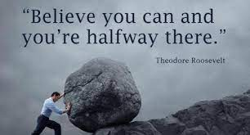
Self-belief
What is Self-Belief?
Self-belief (or self-efficacy) is a person’s belief in their ability to complete tasks and to achieve their goals (Albert Bandura, 1995).
Judging yourself to be capable of success increases your chances of actual success.
Judging yourself as not capable of success reduces the chance of success.

Slide 15
Self-belief Activity
Think of something you do really well
It could be beyond what you do at university e.g. your life at home or at work.
You might see this as a very small skill.
    Are you good at keeping in touch with friends?
    Do you reliably turn up to appointments?
    Do you know how to dress in a stylish way?
    Are you good at DIY or decorating?
Questions
Did this skill happen instantly?
Did you have to work at it and build your self-belief that you could do it well?
How can you apply this to your life at University?

Slide 16
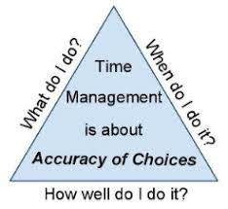
Time Management
Time management is the process of organizing and planning how to divide your time between different activities.
Effective time management allows individuals to assign specific time slots to activities as per their importance.
Time Management refers to making the best use of time as time is always limited

Slide 17
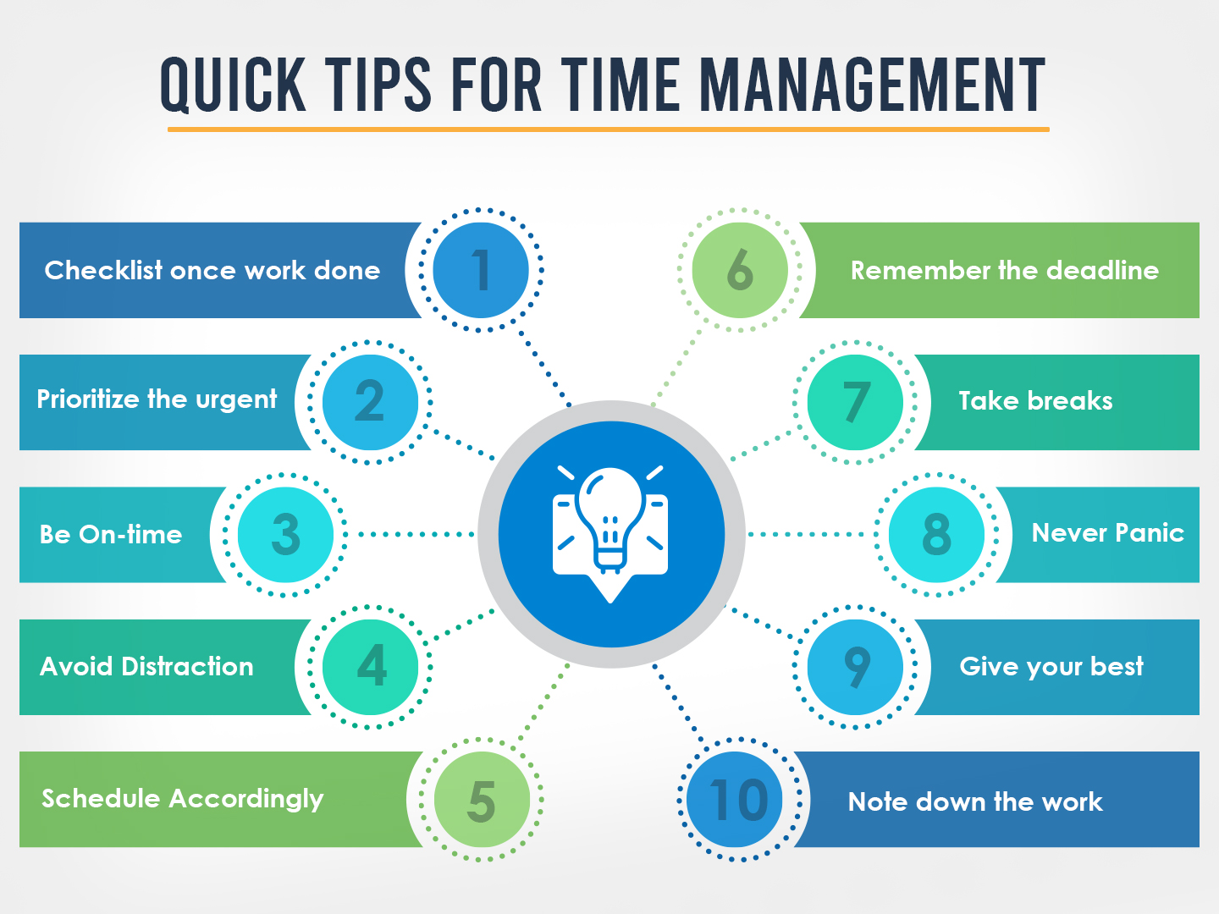

Slide 18

The Benefits of Good Time Management
Greater productivity and efficiency.
Less stress.
A better professional reputation.
Increased chances of advancement.
More opportunities to achieve your life and career goals.

Slide 19
Steps of Time Management
Time Management includes:
Effective Planning
Setting goals and objectives
Setting deadlines
Delegation of responsibilities
Prioritizing activities as per their importance
Spending the right time on the right activity

Slide 20
Effective Planning
Plan your day well in advance. Prepare a To Do List or a “TASK PLAN”. Jot down the important activities that need to be done in a single day against the time that should be allocated to each activity.
Setting Goals and Objectives
Working without goals and targets in an organization would be similar to a situation where the captain of the ship loses his way in the sea. Set targets for yourself and make sure they are realistic ones and achievable.
Setting Deadlines
Set deadlines for yourself and strive hard to complete tasks ahead of the deadlines. Do not wait for your superiors to ask you every time. Learn to take ownership of work.

Slide 21
Delegation of Responsibilities
Learn to say “NO” at workplace. Don’t do everything on your own. The roles and responsibilities must be delegated as per interest and specialization of employees for them to finish tasks within deadlines.
Prioritizing Tasks
Prioritize the tasks as per their importance and urgency. Know the difference between important and urgent work. Tasks which are most important should be done earlier.
Spending the right time on right activity
Develop the habit of doing the right thing at the right time. Work done at the wrong time is not of much use. Don’t waste a complete day on something which can be done in an hour or so.

Slide 22
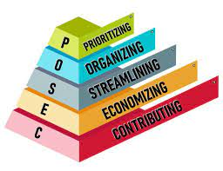
POSEC- Method of Time Management
POSEC is an acronym for "Prioritize by Organizing, Streamlining, Economizing and Contributing".
Prioritize your time and define your life by goals.
Organize things you have to accomplish regularly to be successful (family and finances).
Streamline things you may not like to do, but must do (work and chores).
Economize things you should do or may even like to do, but they're not pressingly urgent (pastimes and socializing).
Contribute by paying attention to the few remaining things that make a difference (social obligations).

Slide 23
MCQs
1. POSEC stands for
a. Prioritize by organizing, streamlining, economizing and contributing
b. Plan with organizing, systematizing, economizing and collecting
c. Prioritize by organizing, segregating, economizing and collecting
d. Plan and organizing, selecting, eliminating and collaborating
3. Resilience is_____________
a. the strength of conviction
b. the ability to bounce back
c. the working of the mind
d. perception towards work
4. Which among the following is not a step in time-management?
a. Delegation of responsibilities
b. Prioritizing activities as per their importance
c. Effective planning
d. Contemplating
5. Which among the following does not form a part of the 7 Cs of resilience
a. Competence
b. Confidence
c. Conciseness
d. Character

Slide 24
Short Answer Type Questions
6. Define tolerance.
7. Enumerate 3 skills through which one can strengthen their resilience.
8. Differentiate between racial tolerance and social tolerance.
9. Elucidate the types of resilience with examples of each.
10. How does time-management make a person more efficient?
11. When is the International day for tolerance celebrated?

Slide 25
References
https://www.mindtools.com/pages/article/newHTE_00.htm
"The POSEC Method of Time Management". Time-Management-Abilities.com. Retrieved 2019-08-29
https://www.managementstudyguide.com/time-management.htm
What Is Tolerance and Why Should We Teach It?
https://www.vocabulary.com/dictionary/tolerance
http://physics.wm.edu/~inovikova/ResiliencePresentation2019.pdf
The 5 most powerful self-beliefs that ignite human behavior By Bobby Hoffman, PhD - September 16, 2015
Shires, Q. "What Is Tolerance? - Definition, Types & Examples“ in Study. Retrieved on 12 September 2017 from Study: study.com
Novikova, I. and Novikov, A. "Tolerance Types and Features of Intercultural Adaptation in International Students"(October 2013) at Research Gate. Retrieved on 12 September 2017 from Research Gate: researchgate.net.
Training in Interpersonal Skills: Tips for Managing People at Work, Pearson Education, India;6 edition, 2015.
The Ace of Soft Skills: Attitude, Communication and Etiquette for Success, Pearson Education; 1 edition, 2013.

Slide 26
Carnegie Dale, Become an Effective Leader, New Delhi: Amaryllis, 2012
Payal Mehra, Business Communication for Managers, Pearson, Delhi, 2012.
Harold R. Wallace et. al, Personality Development, Cengage Learning India Pvt. Ltd; New Delhi, 2006
Barun K. Mitra, Personality Development & Soft Skills, Oxford University Press, New Delhi, 2012.
Mark G. Frank, David Matsumoto, Hyi Sung Hwang, Nonverbal Communication: Science
and Applications, 2012, 1st Edition, Sage Publications, New York.
William S. Pfeiffer, Public Speaking, Pearson, Delhi, 2012.
Human Values, A.N. Tripathi, New Age International Pvt. Ltd. Publishers New Delhi ,2005
Shiv Khera, You Can Win , Macmillan Books, New York, 2003.
S. Kumar and PushpLata, Communication Skills, Oxford University Press,1st, Ed. 2011
Raman M. and S. Sharma, Technical Communication: Principles & Practices, 29th Impression, Oxford University Press, New Delhi, 2009

